Slide 1

The League 101
April 14, 2026

Slide 2

Notes:
Estes Park CO 1934
Credit Unions had some states with state charters available and state-level associations were forming in those states
Came together cooperatively to define, debate and align on the system to grow to more states leveraging the league concept to get more states on board and also support the forthcoming federal legislation (FCU Act 1934).

Slide 3
What is a League?
A state and or regional trade association representing the credit union movement
A unified voice for advocacy at the state and federal level
A connector that brings credit unions together to solve shared challenges
A platform for resources, insights, and industry advancement
We exist to protect, connect, and advance credit unions.

Slide 4
How We Deliver Value
Advocacy
Collaboration
Engagement
Notes:
Advocacy
Protect and modernize the credit union charter
Influence legislation and regulation
Represent a unified industry voice
Member Engagement
Build relationships and trust
Deliver education, events, and insights
Support strategy and connection across credit unions
Foundation
Invest in credit unions through grants
Mobilizes credit union resources through fundraising
Measure and tell our story through the Impact Report

Slide 5

THE MOVEMENT AND MISSION
The Credit Union Difference
A Movement Designed To Serve
Member-owned cooperative structure designed to benefit communities
Created with the mission of ‘People Helping People’
‘Not for profit, not for charity, but for service’

Slide 6
THE LEAGUE OF CREDIT UNIONS
Advocacy in Action
In an increasingly complex legal and regulatory environment, our job is to protect and foster your ability to serve your community.

Slide 7





Notes:
Presenter – Steve and Samantha

Slide 8
THE LEAGUE OF CREDIT UNIONS
Advocacy in Action
The League exists to ensure that credit unions are empowered to continue serving communities long into the future.
We do this through:
Legislative and Regulatory Advocacy
Providing Credit Union Education, Events, and Training Opportunities
Compliance and Risk Support
Networking Through Chapters and Emerging Professionals Programs
LEVERAGE Products and Services

Slide 9
THE LEAGUE OF CREDIT UNIONS
Advocacy in Action
ALABAMA
VIRGINIA
GEORGIA
FLORIDA
THE LEAGUE REPRESENTS THE INTERESTS OF OVER 300 CREDIT UNIONS, RESULTING IN ONE UNIFIED VOICE.

Slide 10

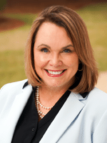



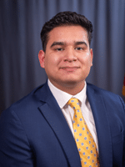


Introduction of Advocacy Team
Sydney Seral​
Chief Advocacy Officer
Michelle Roth
Vice President of Advocacy
Christopher Hodge
Associate Vice President of Governmental Affairs (Florida)
Taylor Morison
Senior Director of Governmental Affairs (Georgia)
Nadine Slocum
Senior Director of Governmental Affairs (Virginia)
Oswald Hernandez
Manager of Regulatory Advocacy
Ibby Dickson
Manager of Federal Advocacy
Jasmine Smith
Senior Director of Advocacy Engagement
Notes:
Need to add Jasmine

Slide 11
Political
Legislative
Regulatory
Compliance
Legal
Grassroots Mobilization
360 Degree Advocacy

Slide 12
DEFINING ADVOCACY
Moving the Credit Union Movement Forward
Building Relationships with Lawmakers
Monitoring and analyzing legislative trends
Influencing legislation through the formation of issue alliances
Supporting candidates for office who understand the credit union difference

Slide 13
DEFINING ADVOCACY
Moving the Credit Union Movement Forward
Meeting with lawmakers and regulators to educate them about potential impact
Ensuring that credit unions have a voice in the formation of new legislation and regulation
Building up grassroots advocates within credit unions and facilitating the formation of credit union - lawmaker relationships

Slide 14
DEFINING GRASSROOTS ADVOCACY
PAC and Grassroots Advocacy
Grassroots advocacy is the strategic mobilization of all stakeholders—employees, members, and community partners—to influence policies and regulations that impact your credit union and the communities you serve.
Calls-To-Action
Collaborating Across the Movement
Political Fundraising
Hosting Lawmakers
Task Forces and Committees
Attending Hill Hikes
Comment Letters
Participating in Project Zip Code
Testifying
Collecting and Sharing Stories and Data
Crisis and Response Readiness

Slide 15
PACs are created and used by organizations for the purpose of raising and spending money to support the election of candidates who are supportive of their respective industries.
The League
PACs
The League offers several ways that credit unions can contribute to PACs and support the election efforts of candidates at the state and federal levels who support the credit union mission.

Slide 16

DEFINING GRASSROOTS ADVOCACY
PAC and Grassroots Advocacy
Hold Elected Officials Accountable
There’s no better way
to grab a legislator’s attention than with potential campaign support- or a lack of it.
Non-Partisan
Regardless of party,
the PAC will support candidates who support credit unions.
Do they visit with CUs?
Are they approachable with issues?
Amplify Credit Union Voices
With other financial institutions competing for the ears of legislators, we are most powerful when we
join together.

Slide 17






PAC AND ADVOCACY FUND OVERVIEW
Three Ways to Support Advocacy with Giving
1
The Advocacy Fund
2
State CUPACs
3
The FedPAC

Slide 18
POLITICAL FUNDRAISING OVERVIEW
PAC and Grassroots Advocacy
The League’s political fundraising structure is designed to maximize impact, flexibility, and accountability.
1
2
3
The Advocacy Fund
State CUPACs
The League FedPAC
Who Can Give:
The League can accept corporate dollars from state and federal-chartered credit unions.
Who Can Give:
The League can accept corporate dollars from state-chartered credit unions and personal contributions upon request.
Who Can Give:
The League can accept personal contributions only.
Contributing to the state CUPACs or League FedPAC are not tax deductible. Contributions are strictly voluntary, and you have the right to refuse without reprisal. Contributions from individuals outside the soliticable class will be
returned. Federal election law requires us to report the name, occupation, and/or name of the employer for individuals who contribute $200 or more in a calendar year.

Slide 19
League Compliance Resources
Compliance Corner
Compliance Hotline
Compliance Consulting Services
On Demand Compliance Training
CU Webinar Network
InfoSight360
League InfoSight
CU Policy Pro
CU Recovery Pro
Upcoming: Virtual Compliance and BSA Workshop

Slide 20
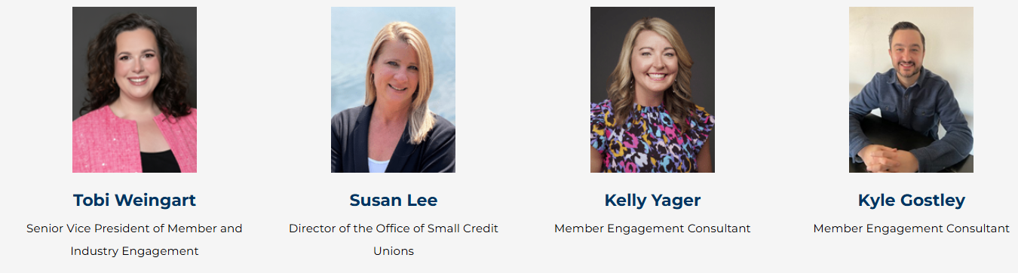
Member Engagement Consultants
The goal of Member Engagement is to enhance the value we provide to credit unions by fostering deeper relationships, streamlining processes, and delivering personalized service.
Notes:
Presenter – Samantha

Slide 21

League Resources
Advocacy
Collaboration
Impact
Annual signature events
ENGAGE
EMERGE
State Advocacy Summits
GAC and Hike the Hill
CEO and C-Suite Summit
INSPIRE
Topical and state gatherings
Bi-monthly calls
Professional development and
training
Communities
Credit Union Impact Foundation
Office of Small Credit Unions
Custom Engagement Plan
Professional Development Mapping
PR and Crisis Communication Support
Product Recommendations
State and Federal Advocacy
Legislative
Regulatory
Legal
Compliance
Advocacy Engagement
PAC
Grassroots
Training

Slide 22

Emerging Professionals Network
EPN provides an exciting platform for emerging leaders to connect, collaborate, and create lasting impact.
Industry Awareness: Equip emerging professionals with a deeper understanding of the credit union industry and its future challenges and opportunities.
Professional Growth: Provide ongoing learning and development opportunities to help members expand their skills and advance their careers.
Collaboration: Cultivate a supportive community where young credit union leaders can exchange ideas, share best practices, and build valuable networks.
https://the-league.coop/join-emerging-professionals-network/

Slide 23

Office of Small Credit Unions
Support the unique needs of small credit unions
Strengthen long-term sustainability and growth
Provide tailored resources and expert guidance
Connect peers to share solutions and learn from each other

Slide 24
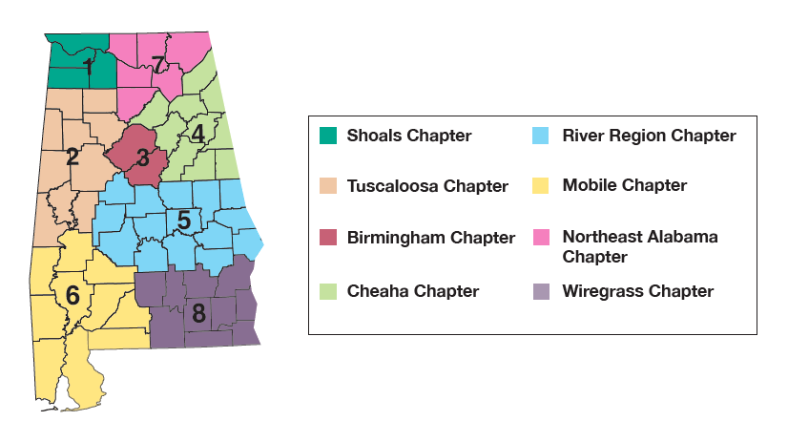
Alabama Credit Union Chapters

Slide 25
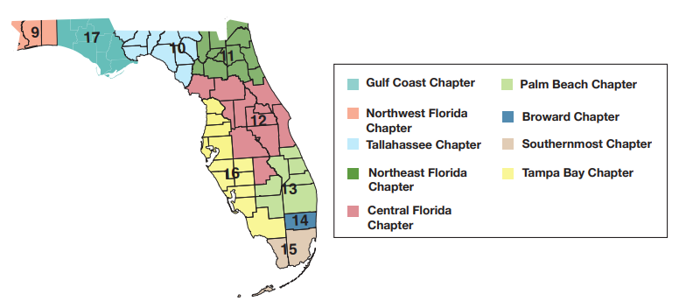
Florida Credit Union Chapters

Slide 26
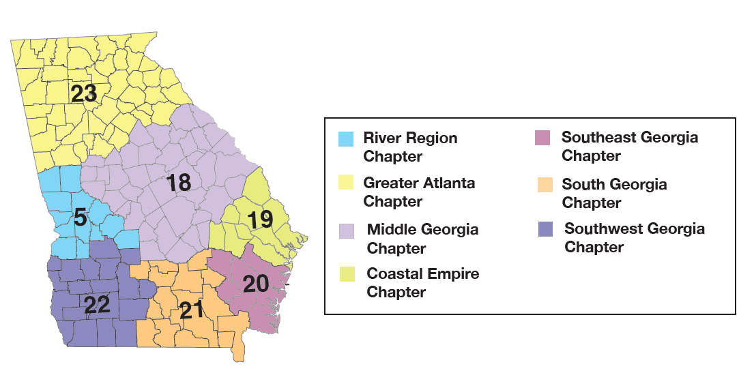
Georgia Credit Union Chapters

Slide 27
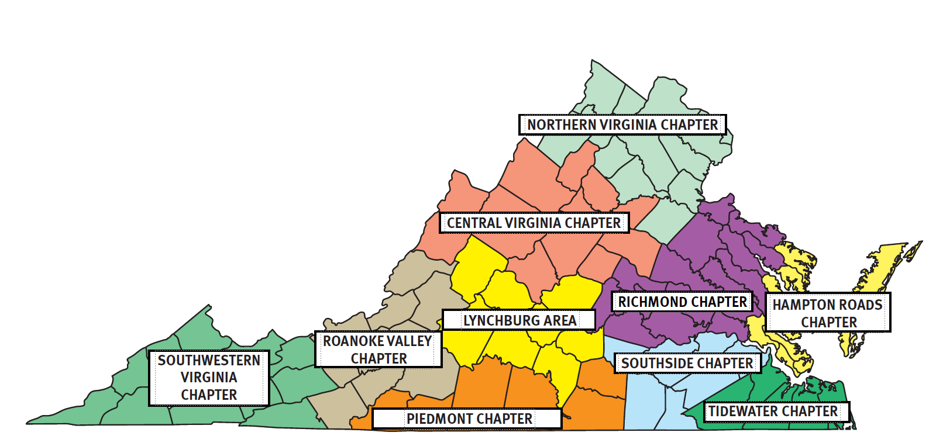
Virginia Credit Union Chapters
Richmond (Active)
Tidewater (Active)

Slide 28







Slide 29
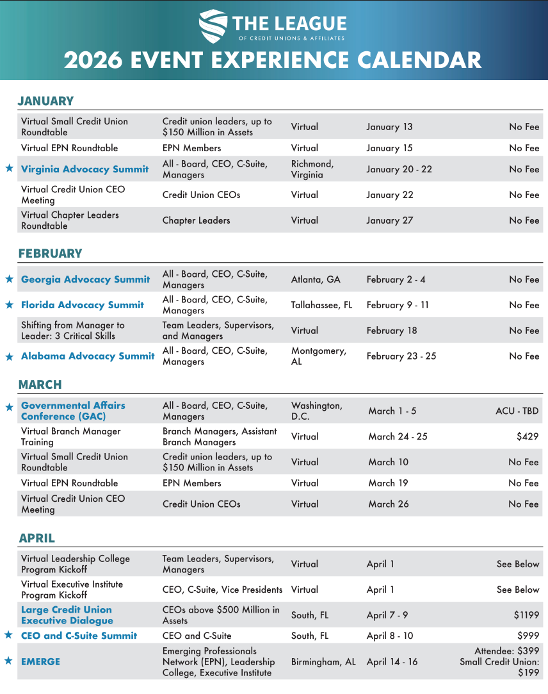
Events
EMERGE: April 14 – 16
5th Annual CULS Charity Golf Invitational: May 4
ENGAGE: June 9 – 12
Southeast Regional Directors Conference: August 2 – 4
Cybersecurity and Fraud Summit: October 1 – 2
International Cooperative Learning Journey: October 11 – 17
INSPIRE: October 26 – 28
Notes:
Presenter – Samantha

Slide 30
Education
Leadership Journey:
Leadership College/EMERGE
CULC - Credit Union Leadership Coach
CCUC - Certified Credit Union Collaborator
Executive Institute
ODCM - Organizational Design and Change Management Certification
Southeast CU Management School
SRCUS – CCUE - Certified Credit Union Executive
Virtual Education:
Branch Manager
Compliance and BSA
IRA
Future of Digital Currency
Notes:
Presenter – Samantha

Slide 31



How Do You Develop Your Team and Leaders?
Development & Leadership
On-Demand: 150+ Webinars​
7 - 10 Virtual Trainings – some in collaboration with other leagues
Notes:
Presenter – Samantha

Slide 32

Website and Resources for You
Safelist:
@the-league.coop
@myleverage.com
@mycuservices.com
The League Insider (high-level events and updates shared every Tuesday and Thursday)
Compliance Corner (compliance and risk newsletter shared every other Wednesday)
LEVERAGE Monthly (products and solutions-oriented information shared monthly)
Biweekly Beeler Brief (executive-level newsletter shared every other Monday)

Slide 33

Credit Union Impact Foundation: New Branding, Same
Mission, Expanded Focus Bobbi Grady, CUDE, ODCM Foundation Executive Director

Slide 34
HOW WE GET THERE
Disaster Resilience
Employee Enrichment
Community Impact
Sustainable and Diverse Funding
Enhance the ability of credit unions and their staff to prepare and recover from natural disasters.
Nurture the development of credit union professionals to excel in their career
Amplify credit unions' efforts to create meaningful change in the communities they serve.
Secure financial stability drive the philanthropic mission in support of credit unions and their communities.

Slide 35
Growth and Impact Program
The Growth and Impact Program was designed to better support The League of Credit Unions & Affiliates’ member credit unions and chapters in their efforts to enhance their communities and spur credit union philanthropy.
The Foundation offers the following grants:
Community Impact Grants
Credit Union Development Grants
Professional Development Grants
Progress Fund

Slide 36
Community Impact Grants
The Community Impact Grant program prioritizes funding projects aimed at removing barriers to the well-being and prosperity of credit union members and their communities. These projects focus on several key areas, including financial literacy, holistic wellness, housing stability, and food security for both credit union members and their communities.
Maximum grant amounts are $5,000 for credit unions and $1,500 for Chapters.
Funding Priorities
Financial Wellness and Education: Projects promoting financial literacy, wholistic wellness, housing stability, and food security for credit union members and their communities.
CDFI Support: Projects that assist credit unions in obtaining Community Development Financial Institution (CDFI) certification and applying for CDFI Fund grants by providing funding for grant writing assistance.

Slide 37
Credit Union Development Grants
The Credit Union Development Grant Program aims to support the growth and sustainability of credit unions by providing financial assistance for projects that improve staff and volunteer development, technology adoption, operational efficiency, and innovation.
Maximum grant amounts are $5,000 for credit unions.
Funding Priorities
Equipment and Technology: Provides financial support for the acquisition, implementation, and upgrade of equipment and technology systems that enhance credit union services and operations.
Marketing: Supports credit unions in promoting their services, raising their profile in the community, and engaging with their members.
Succession Planning: Provides financial support to help credit unions plan for leadership and management transitions, ensuring continuity and stability.
Innovation: Prioritizes projects that promote innovation within credit unions.

Slide 38
Professional Development Grants
The Credit Union Impact Foundation awards professional development grants throughout the year for credit union CEOs, employees, board members and supervisory committee members to attend The League of Credit Unions & Affiliates and America's Credit Unions’ educational events.
The professional development grants program is designed for smaller asset size credit unions and credit unions with financial hardships.
The grants not only cover tuition or registration fee but may also cover a portion of travel costs.
Professional development grants are awarded to individuals who best exemplify the credit union philosophy, and whose attendance at approved programs would be beneficial in the perpetuation of credit union goals and ideas.

Slide 39
Disaster Resilience and Recovery Grants
In times of natural disasters, concern for our credit unions and the communities they serve is a top priority for The League of Credit Unions & Affiliates and the Credit Union Impact Foundation.
The disaster preparedness and relief resources include:
Small grants are available to credit union employees and board members to assist with immediate needs related to housing, transportation, and certain basic living expenses.
Disaster Preparedness and Relief Resources

Slide 40


Financial Wellness
The Foundation provides financial wellness and educational resources to better enable credit unions to reach all age groups and to improve overall financial health.
Programs and Services include:
Financial Counseling Certification and Recertification Program (FiCEP)
Bite of Reality App
Links to Resources

Slide 41
FiCEP Program
The Credit Union Impact Foundation partnered with America's Credit Unions and CU Difference to offer an exceptional financial counseling training program for credit union staff and volunteers. The program, called the Enhanced Financial Counseling Certification Program (FiCEP), combines self-study with instructor-led webinars and networking opportunities.
The Enhanced FiCEP program is tailored for credit union staff who work in financial counseling, collections, loan departments, and other roles that involve supporting members in achieving better financial health.
This program equips credit union staff with the skills to counsel members effectively, enabling them to improve their budgeting, savings, debt reduction, and future planning.
Participants who successfully complete the program and exam earn the prestigious Certified Credit Union Financial Counselor (CCUFC) designation. This certification demonstrates proficiency in critical financial counseling skills and concepts, empowering participants to provide superior service to credit union members and guide them towards greater financial stability.

Slide 42


Bite of Reality
Bite of Reality is a hands-on app-based simulation that appeals to teens while giving them a taste of real-world financial realities. Teens are given a fictional occupation, salary, credit score, spouse and a child, student loan debt, credit card debt, and medical insurance payments. The teens then walk around to various table-top stations to “purchase” housing, transportation, food, clothing, and other needs. Fortunately, the game also includes a “credit union” to help with their financial needs.
This interactive activity will teach teens how to make financial decisions and give them a better understanding of the challenges of living on a budget. Teens will have to deal with a pushy “car salesperson” and a commission-based “realtor,” and weigh their wants versus their needs. There’s even a “Fickle Finger of Fate” that will give the students unexpected “expenses” or “windfalls”—just like in real life.

Slide 43

Who We Are
Friends of the Foundation is the membership program of the Credit Union Impact Foundation, offering financial wellness benefits, volunteer opportunities, and access to credit union products/services. Membership enables active participation in the Foundation's priorities and supports disaster resilience, credit union development, and community impact programs.
What We Do
We're dedicated to our mission of serving credit unions, communities, and their members worldwide. As a Friend of the Foundation, you can highlight the collective strength of credit unions for positive change. Your involvement directly supports credit union sustainability, ensuring resilience and impact for years to come.

Slide 44

Feedback and Open Discussion

