Slide 1


Presentation Title

Slide 2

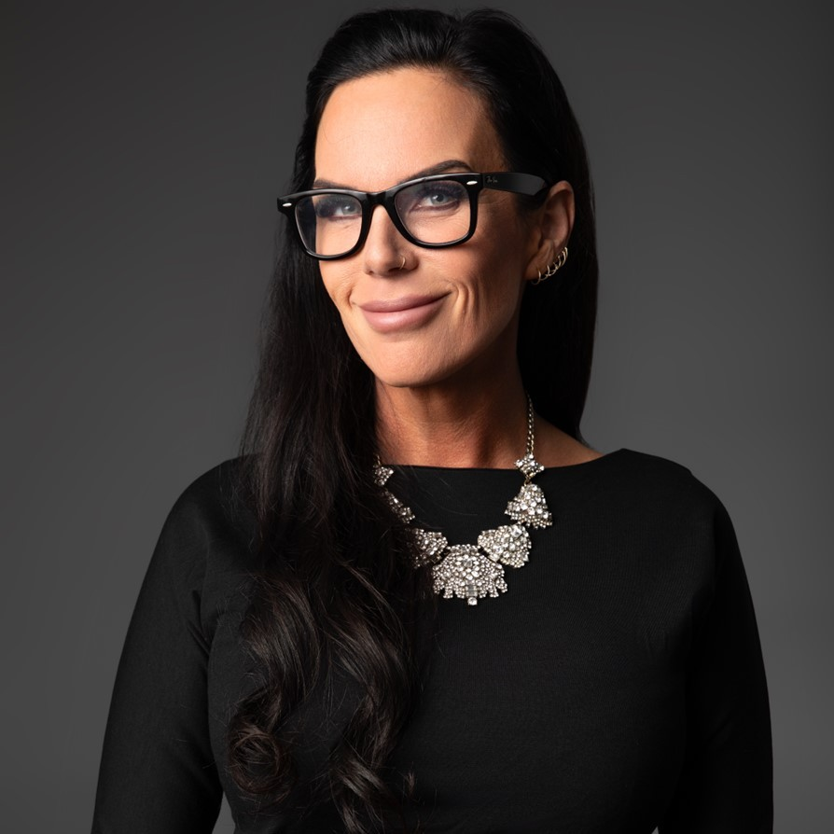
Your Credit Union Why
Dr. Brandi Stankovic
Principal
Strategic Advisory Solutions

Slide 3
Break

Slide 4
Certified Credit Union
Cooperator (CCUC)
Graduation

Slide 5
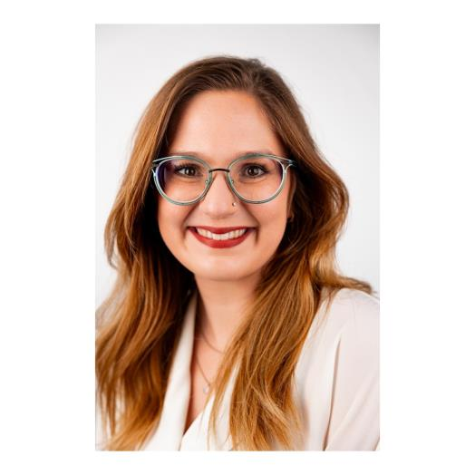
Kelsie Davis Memorial
Leadership Journey Scholarship

Slide 6
Presentation Title

