Slide 1


Presentation Title

Slide 2

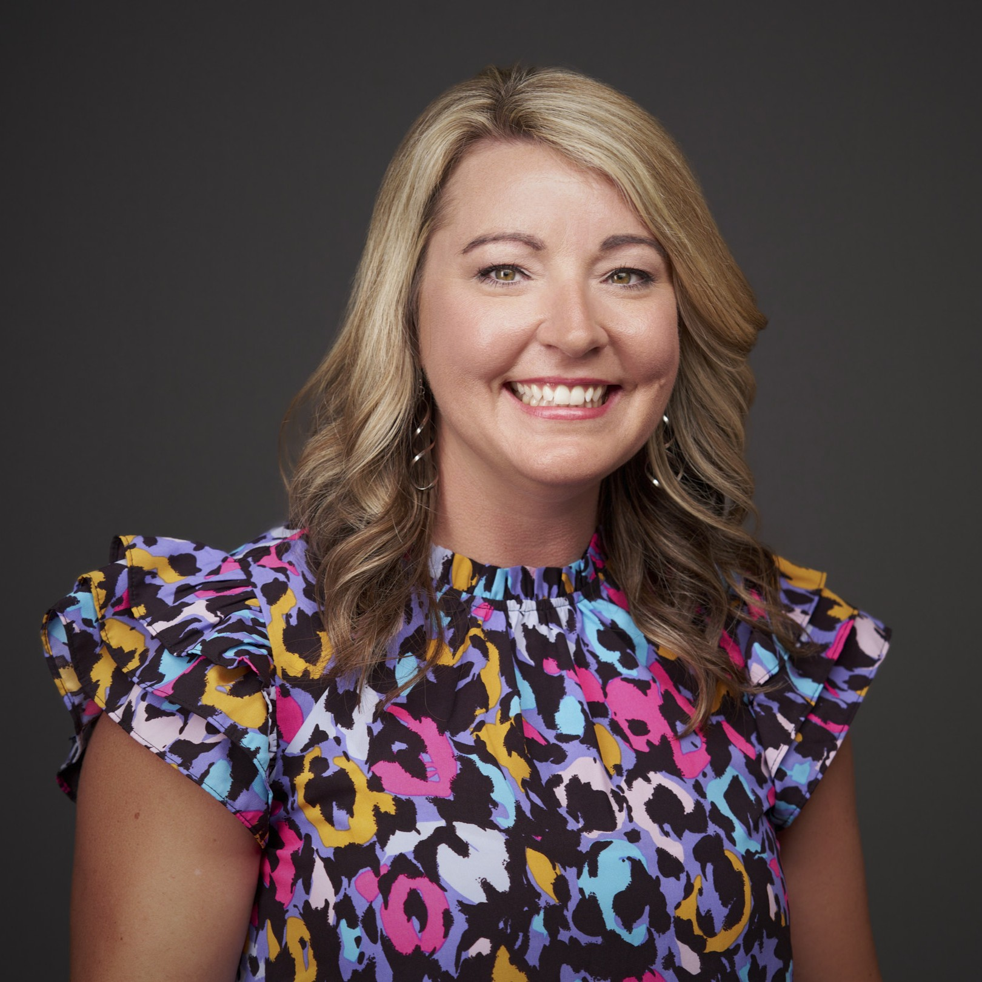
Welcome
Kelly Yager
Member Engagement Consultant
The League of Credit Unions

Slide 3
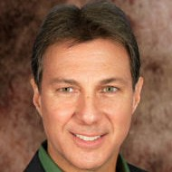

Title Sponsor
Pete Pritts
CEO
Corporate America

Slide 4
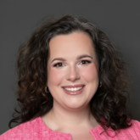
Credit Union History and Heroes
Tobi Weingart
Senior Vice President of Member and Industry Engagement
The League of Credit Unions

Slide 5
Break

Slide 6
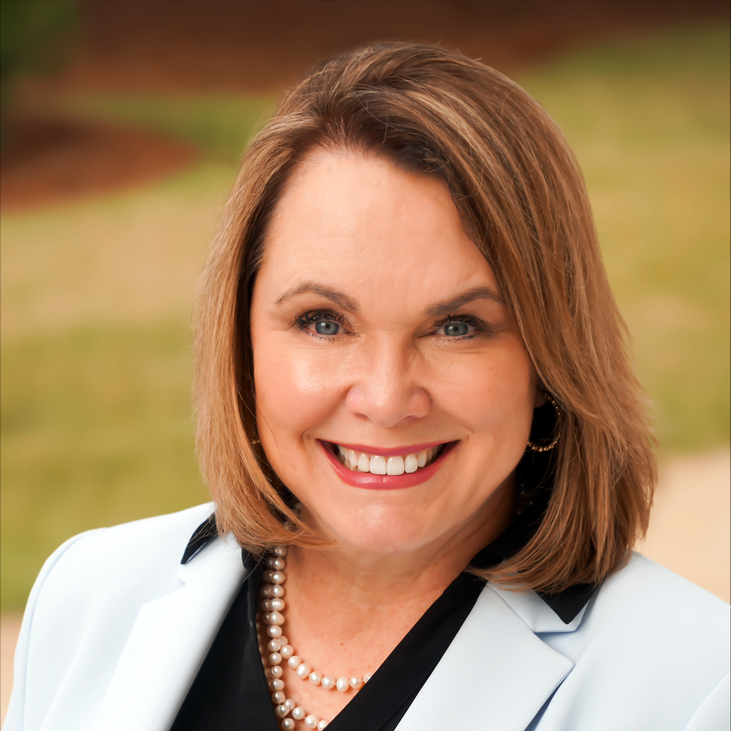
Advocacy Simulation
Michelle Roth
Vice President of Advocacy
The League of Credit Unions

Slide 7
Lunch

Slide 8

A Video Message from

Slide 9
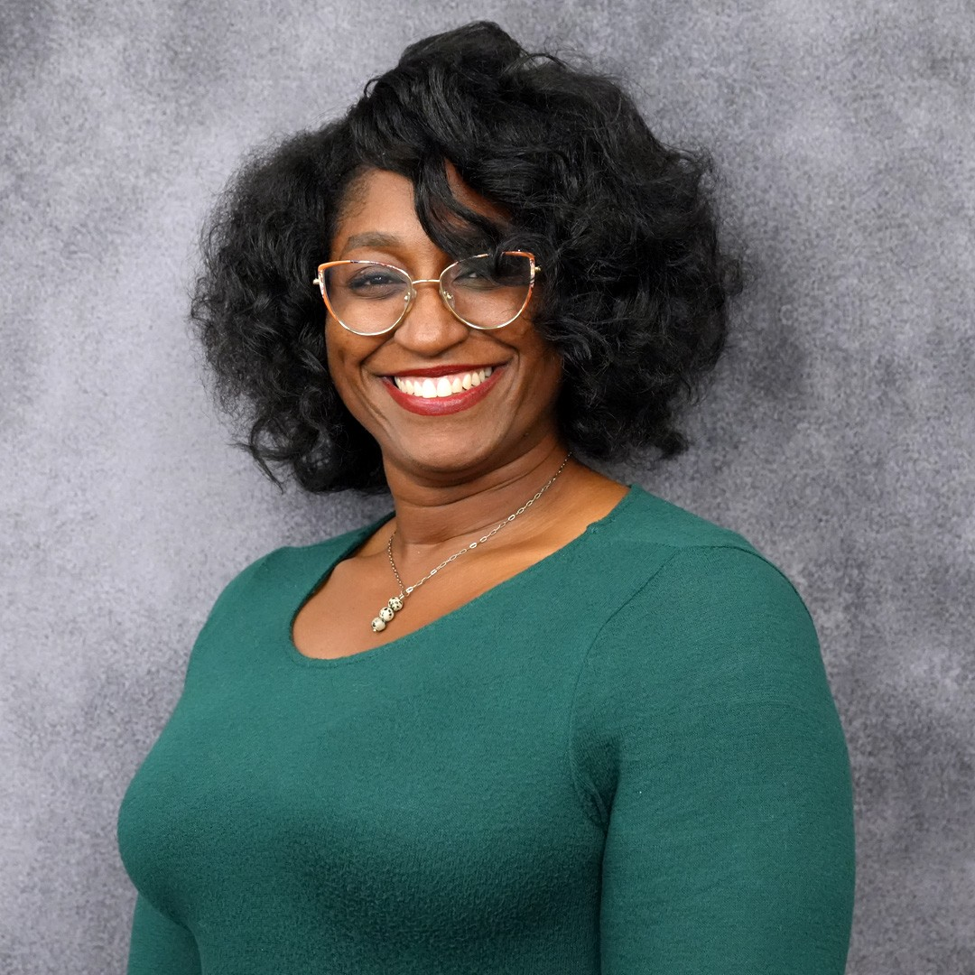
Leadership Panel
Navigating a Career Path in Credit Unions
Nikita Mathews
Financial Education Program Leader
AmFirst

Slide 10
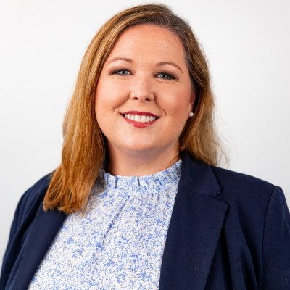
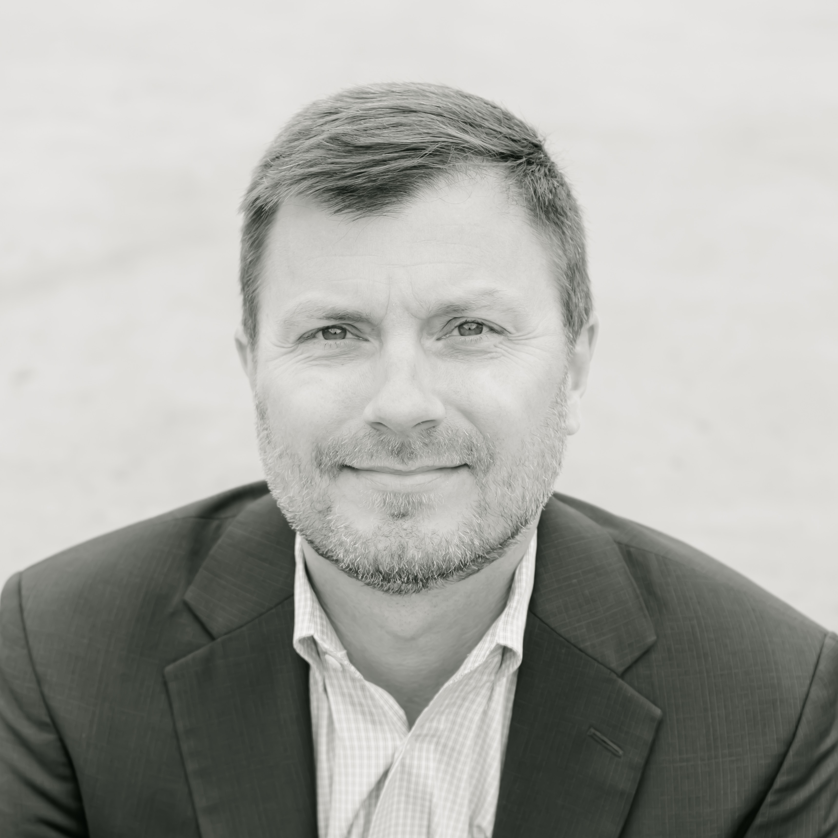
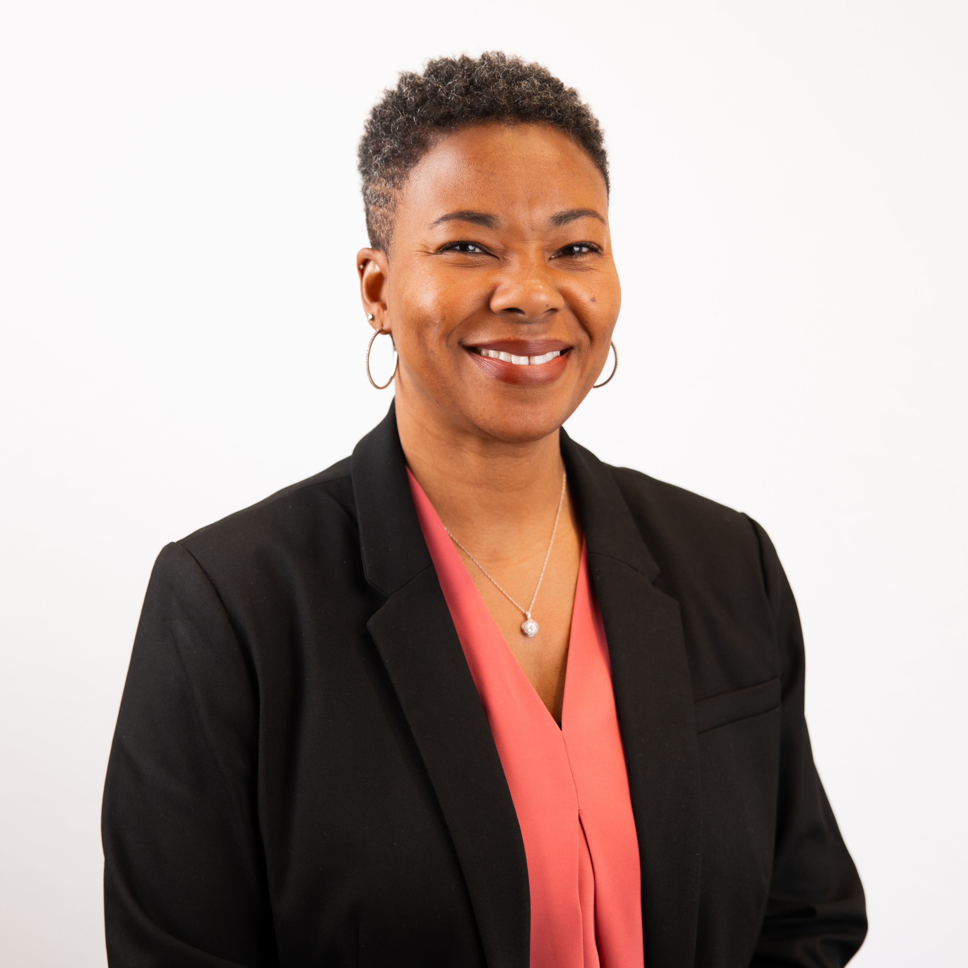
Leadership Panel
Navigating a Career Path in Credit Unions
Alison Cooke
Judd Davis
Summer Carter
CEO
CEO
Senior Vice President of
Member Experience
ACIPCO Federal
Credit Union
Health Credit Union
Legacy Community
Federal Credit Union

Slide 11
Break

Slide 12
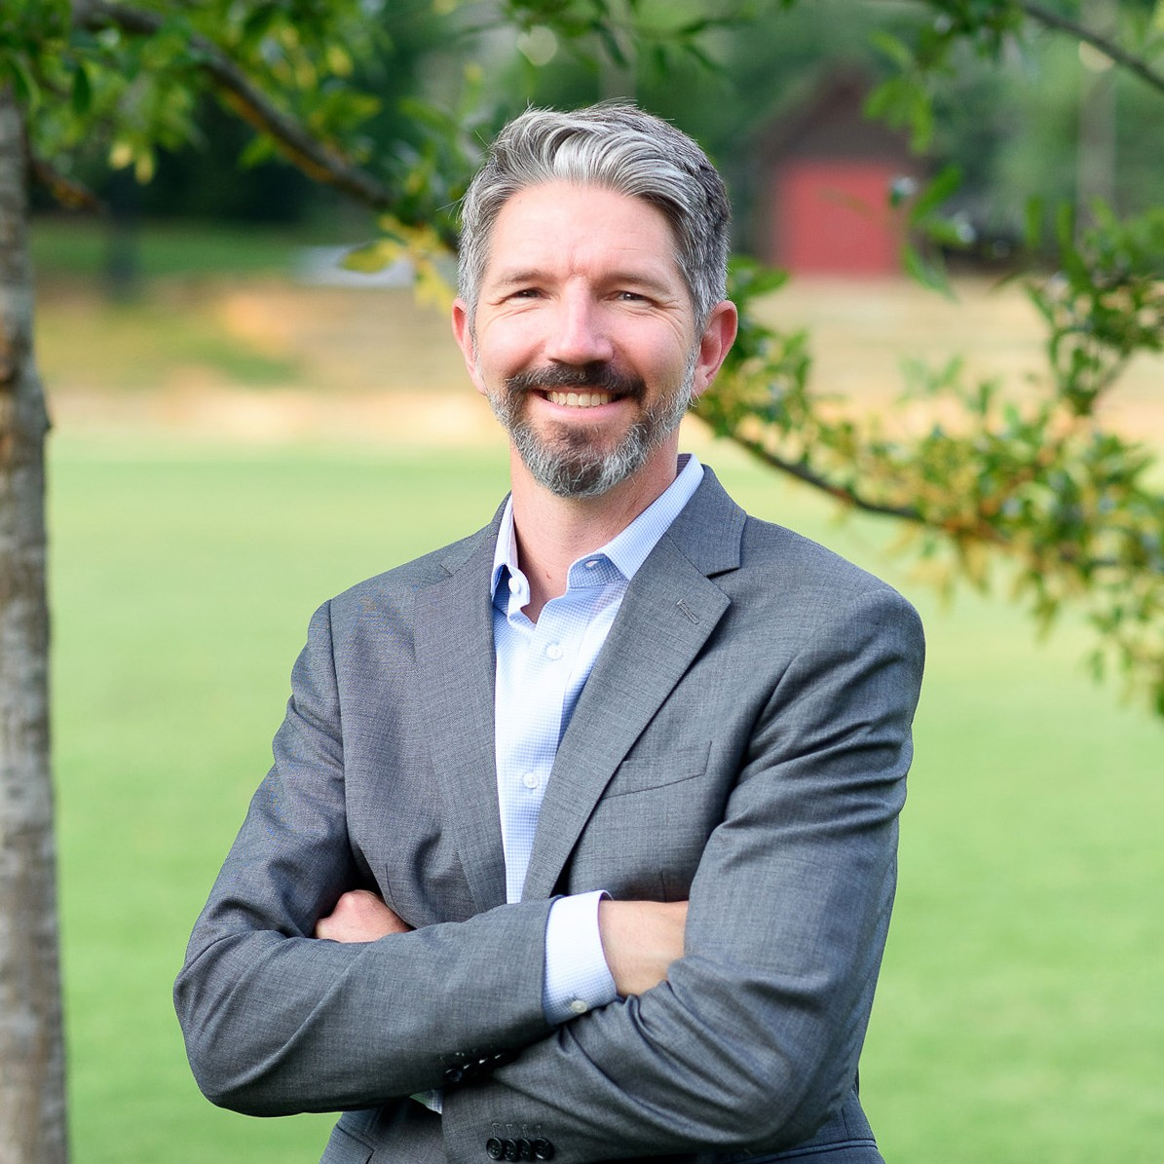
ALICE Initiative
Nick Sims
Vice President of Allocations and Grants
United Way of Central Alabama

Slide 13
Poverty Simulation

Slide 14
Power Hour Roundtables

Slide 15
Power Hour Roundtables
Accounting/Back Office Support
Compliance/Fraud
Lending/Collections
Marketing/Technology
Operations/Member Experience

Slide 16
Presentation Title

